Slide 1
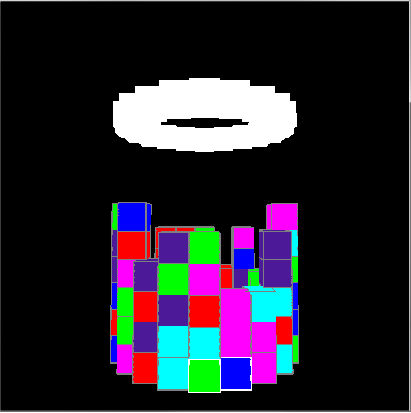
Custom Topic – Tetris variant
Similar to “Tetris Attack”
Requirements
Circular “column” of blocks rendered in 3d
User can select and swap blocks with a cursor, which the camera follows
Blocks disappears when 3 or more are lined up
Blocks above fall to fill in gaps

